Slide 1


Real Estate France Data and Prediction Analysis
Abonia Sojasingarayar-M2
September ,2020 Artificial Intelligence-IA School

Slide 2





Table of Content
Introduction
Dataset
Database ER Diagram
DVF Dashboard
Data Analysis and Visualisation
Land Value Prediction
ML Algorithm Comparision
Feature Importance
Future Work
Conclusion

Slide 3
Introduction
This project show descriptive analysis of real estate data of France(territoire métropolitain et les DOM-TOM) except Alsace-Moselle and Mayotte.Dataset was splited and arranged based on years.Here with this project we will use data from last 5 years.
i.e 2015,2016,2017,2018,2019.
Dashboard was developed in order to give better insight on where and in which land type to invest on.
Additionally, ML model was developed to predict the land value based on given data

Slide 4
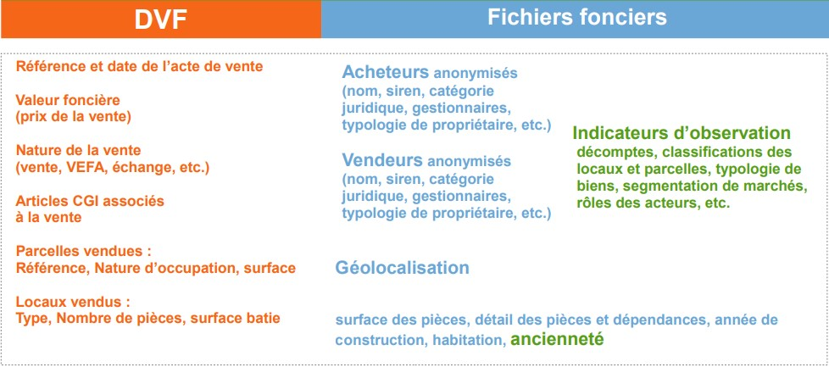
Dataset

Slide 5
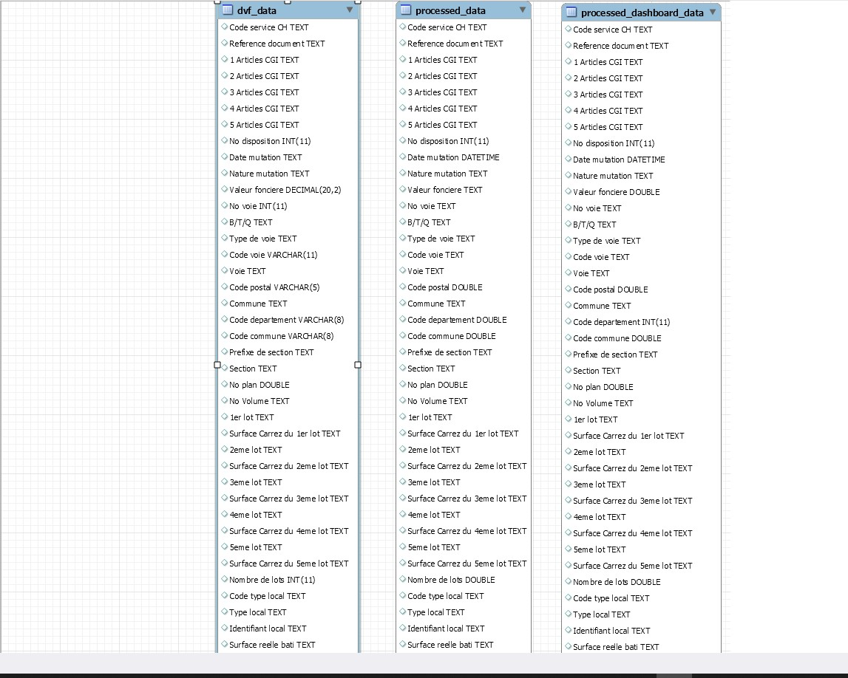
Data Schema

Slide 6
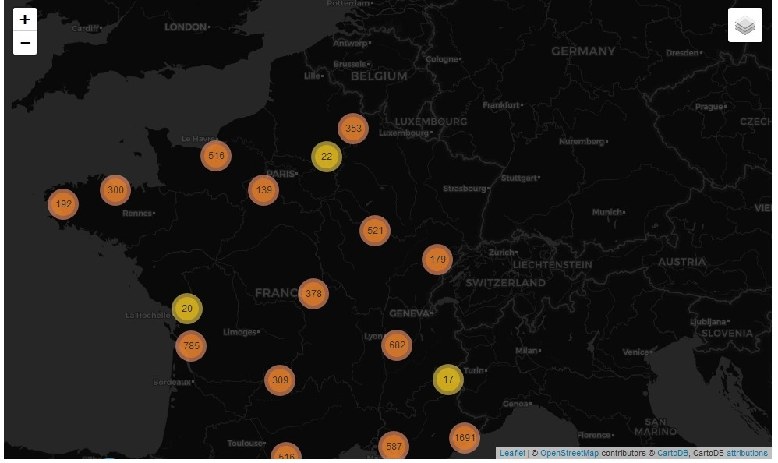
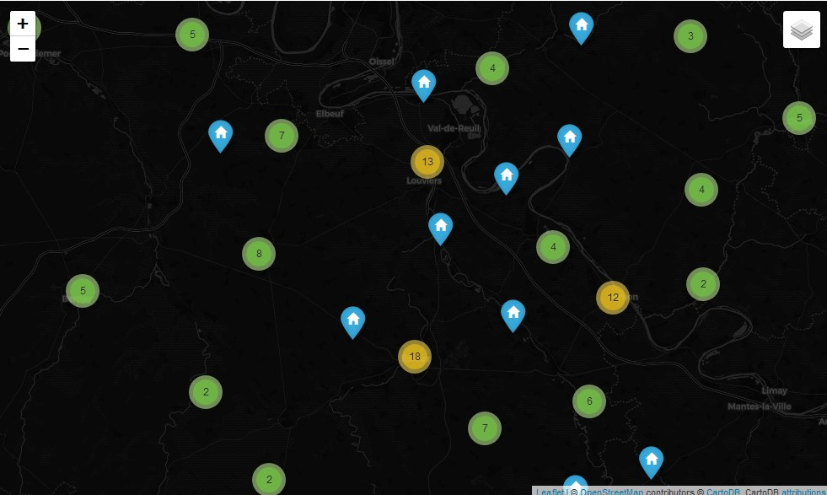
Geo Exploratory

Slide 7
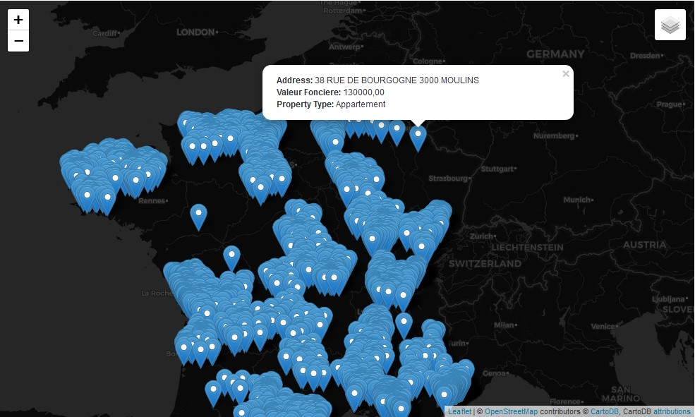
Geo Exploratory

Slide 8
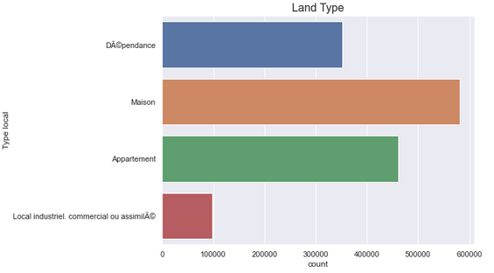
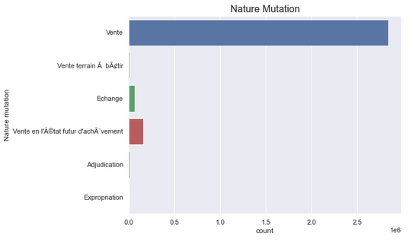
I. Count Land Type
II. Count Mutation Nature

Slide 9
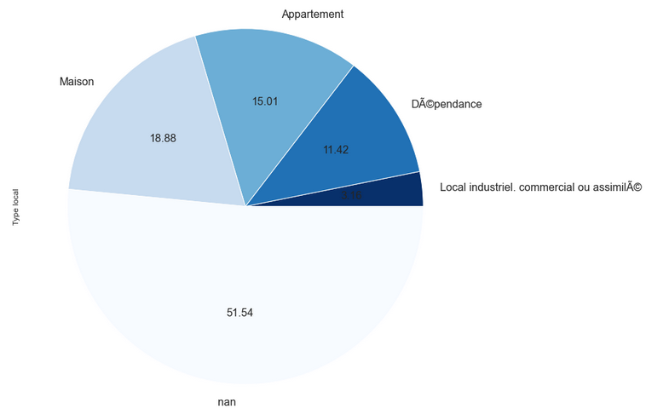
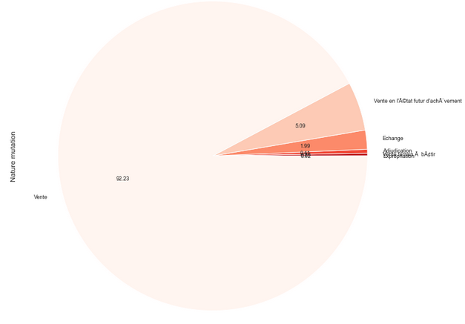
I. Distribution of land Type
II. Distribution of Nature mutation

Slide 10
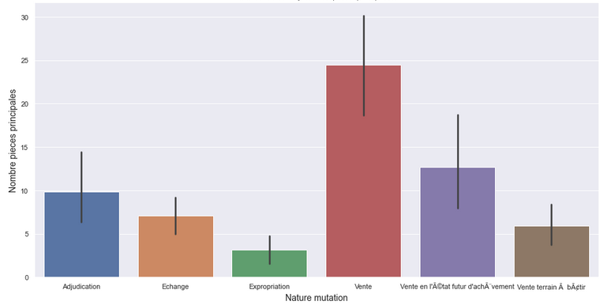
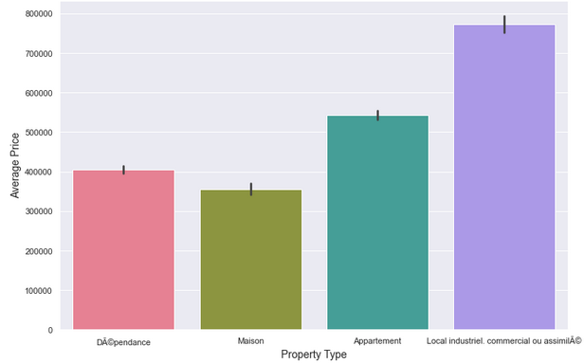
I. Nature Mutation by Number of rooms
II. Average Land price by Property type

Slide 11
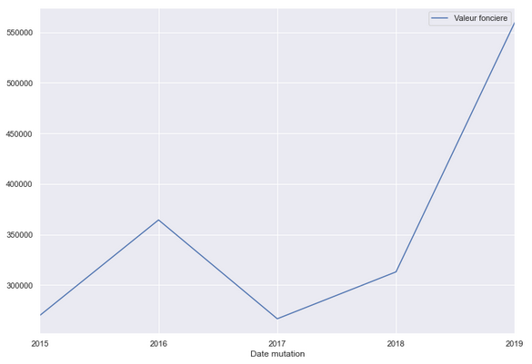
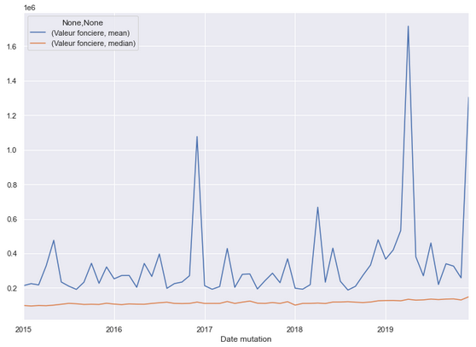
I. Growth of Sale vs Year
II. Mean And Median Land value vs Year

Slide 12
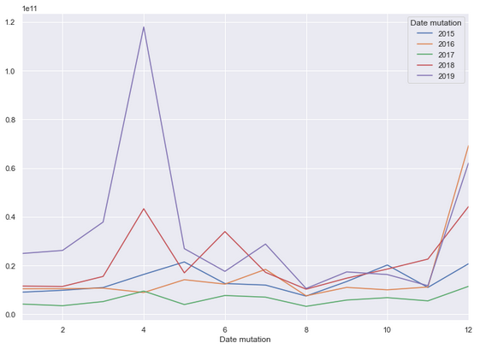
Land value by month for different year

Slide 13
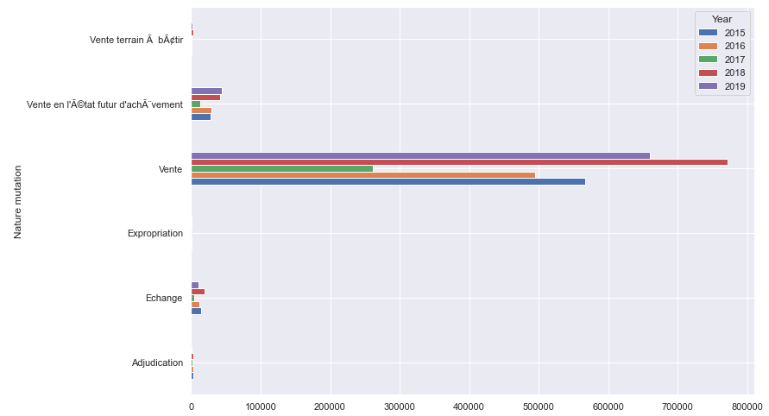
Evolution of number of sales per year

Slide 14

DVF DASHBOARD
Excel Dashboard

Slide 15
Data Preprocessing
Remove duplicates from our data
Check for null values and manage missing values in data.
Remove columns which are mostly empty
Number of rooms is null i.e there is no room so we fill nan with 0
Label missing categorical data

Slide 16
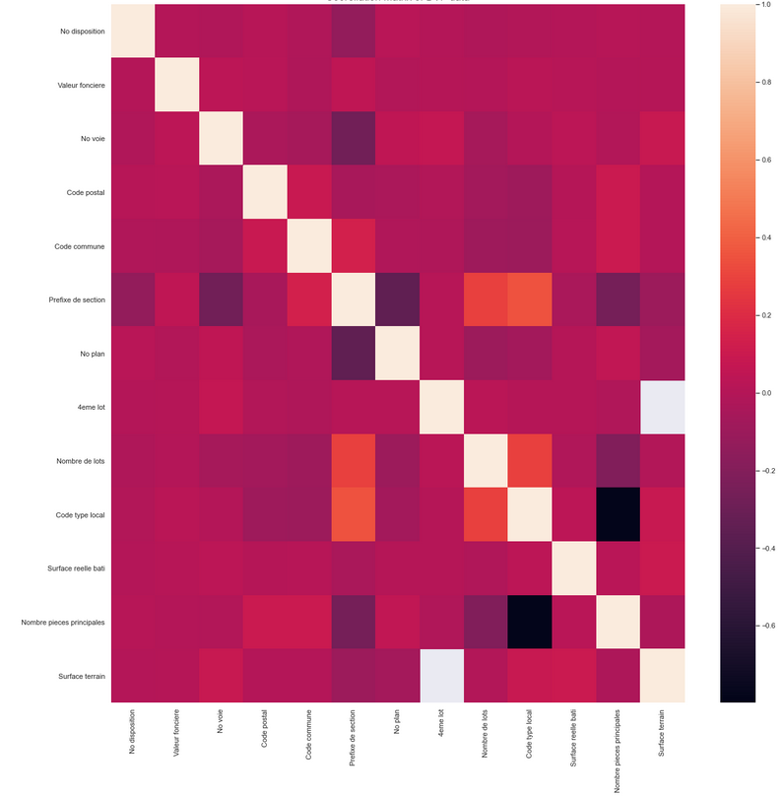
Correlation Matrix

Slide 17
Compare All Model
Models | RMSE |  | R-Squared |  | MAE
 | Train | Test | Train | Test | Train | Test
1. Baseline | 2618628 | 2420826 | 0.0 | -2.4247 | 424423 | 414264
2. Ridge Regression | 2604610 | 2406489 | 0 .0106 | 0.0117 | 425782 | 416089
3. Support Vector Regression | 2614102 | 2425329 | 0.0034 | 0.0037 | 235139 | 292657
4. Random Forest Regression | 1032333 | 1412072 | 0.8445 | 0.6597 | 155266 | 259615
5. XGBoost Regression | 691762 | 1100200 | 0.9302 | 0.7934 | 145032 | 238114
6. Lasso Regression | 2597767 | 2399898 | 0.0158 | 0.0171 | 428603 | 418972
7. Decision Tree Regression | 1266414 | 1499296 | 0.7661 | 0.6164 | 222370 | 264544
8. KN Regression | 1763648 | 2076837 | 0.546 | 0.2639 | 261636 | 371673

Slide 18
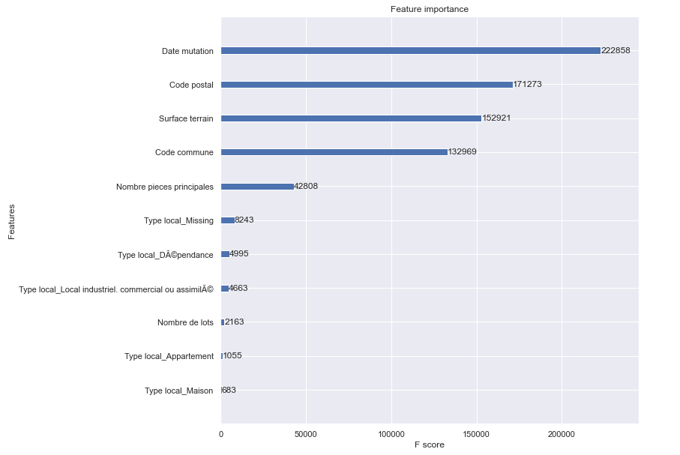
Feature Importance

Slide 19
Future work
1.Dataset preprocessing must be improved further to produce better result.
2.Hyperparameter optimization can be improved by trying with unused combination of parameters.
3.Using only the top best important features with algorithm can improve model performance.
4.Use different parameter with different values can also improve the model performance in future.

Slide 20
Conclusion
Our model performance is good but still need an improvement in future.
Important features such as Date, Postal code, Commune code, Land types, Land Surface plays important role in prediction land value.
So this analysis can answer to the investor’s questions such as what land type is good and bad for investment, Evolution of price with year, Distribution of sale based on number of rooms etc…
Geographical exploration gives ideas about where we can invest in order to have significant profit in future.

Slide 21


